Slide 1

Stakeholder engagement update July 10, 2024
Paul Kabera
Community Engagement Coordinator
HIV Prevention & Care Project
School of Public Health
University of Pittsburgh

Slide 2
The Big Picture
Pennsylvania’s HIV prevention and care services are guided by a multi-year plan called the Integrated HIV Prevention and Care Plan (IHPCP).
Pennsylvania’s current plan covers 2022 to 2026.
Our federal funders, HRSA and CDC, not only require us to develop and follow an IHPCP, they require us to develop an IHPCP that reflects stakeholder insights.
HPG’s writing of the next IHPCP should begin in less than 12 months.

Slide 3
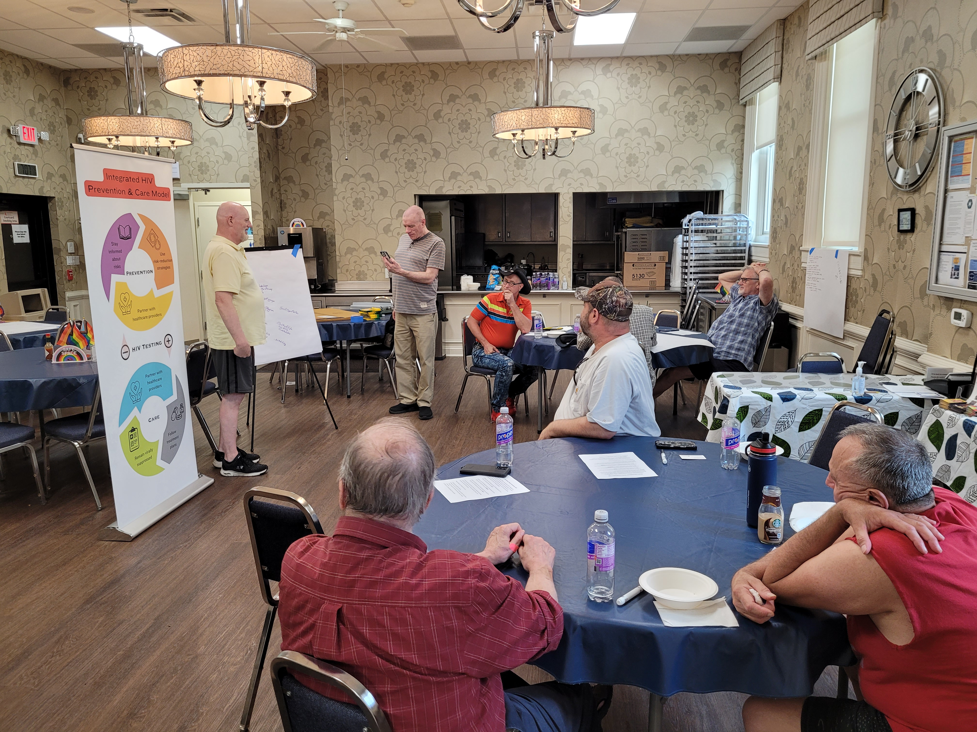
Activity Update
HPG approved a Pennsylvania Thinks conversation café pilot with Shepherd Wellness Community. The pilot ran on June 20th as scheduled. Seven SWC members turned out.

Slide 4
Activity Update
The next Pennsylvania Thinks conversation café is scheduled for August 30th. It is being hosted by Hamilton Health Center, here in Harrisburg.
I am currently talking with five additional organizations around the state about hosting a Pennsylvania Thinks conversation café.

Slide 5
Moving Forward: Options Recap
Conversation Cafés: Stakeholder-driven exchange of ideas in small group format.
Focus Groups: Facilitator-driven exchange of ideas among similar individuals.
Key-Informant Interviews: One-on-one probe of a particular individual’s perspective.
Surveys: Tool for gathering discrete data from a sample group to understand characteristics of a larger population.

Slide 6
Moving Forward: Collaborative Approach Approved at May HPG Meeting
Transition from conversation cafés alone to a menu-based engagement approach.
This maximizes responsiveness and flexibility to both HPG/Division ideas and stakeholder feedback.
Multiple methods increase agility within remaining IHPCP development window.
Ongoing dialogue between Stakeholder Engagement Coordinator and HPG members / Division representatives.
Agreed to have a standing “stakeholder engagement” update at every HPG meeting.

Slide 7
Moving Forward: Timeline Approved at May HPG Meeting
May – November, 2024: Schedule and hold conversation cafés at multiple locations in Pennsylvania.
May – November, 2024: Ongoing collaborative dialogue with HPG/Division about the stakeholder engagement process.
September, 2024 – January, 2025: Collaborative dialogue continues. Early steps toward other methods (focus groups, key-informant interviews, surveys).
January, 2025 – July, 2025: Collaborative dialogue continues. Mixed methods continue. Plans gel for how stakeholder voices will dovetail with next IHPCP.

Slide 8
Moving Forward: Please call, text or email me
Paul Kabera
Anytime mobile phone: 412-441-4441
phk28@pitt.edu

