Slide 1
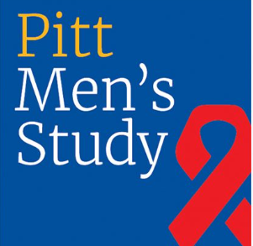
40 Years of the Pitt Mens Study
How Community Creates Better Research
Ken Ho, md, mph
7/10/2024

Slide 2
<iframe src="//cdn.jwplayer.com/players/3zMxqw2G-IpUyiJUa.html" width="640" height="360" frameborder="0" scrolling="auto"></iframe>

Slide 3
What is the Pitt Mens Study?
The Pitt Men’s Study (PMS) is a confidential research study of the natural history of HIV/AIDS, funded by the National Institutes of Health that has been ongoing in Pittsburgh since 1984.
Cohort of approximately 3000 men to gather information on the epidemiology, virology, immunology, and pathology of the HIV.
Originally part of the Multicenter AIDS Cohort Study (MACS)
In 201 MACS/WIHS Combined Cohort Study (MWCCS), collaborative research effort that aims to understand and reduce the impact of chronic health conditions—including heart, lung, blood, and sleep (HLBS) disorders—that affect people living with HIV
Funding through NHLBI (National Heart Blood Lung Institute)

Slide 4
Pitt Mens Study at a Glance
1,811 people have participated in the Pitt Men’s Study
438 are still-active participants
201 of those who joined in 1985 or before
539 have died from AIDS or other causes.

Slide 5
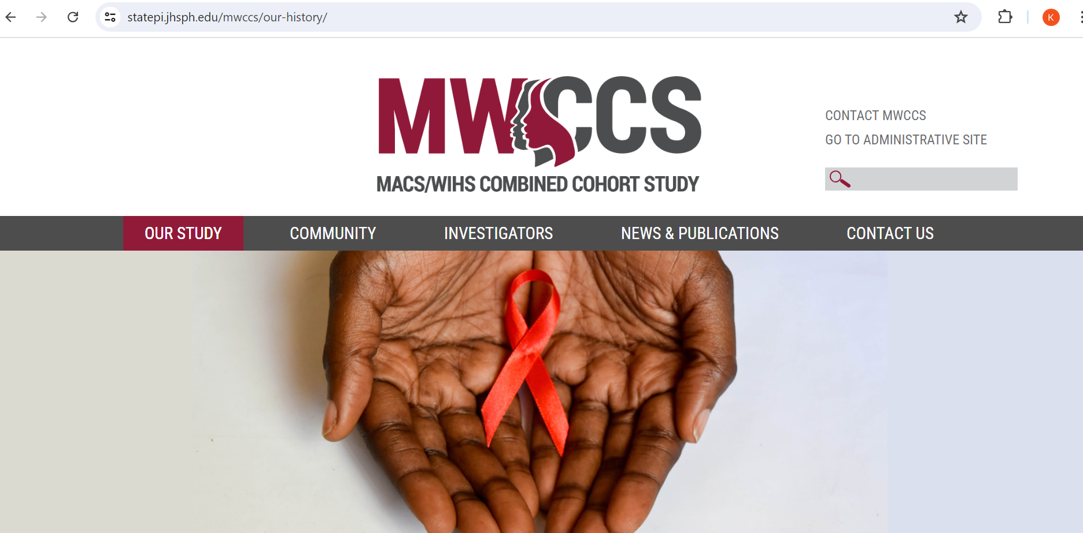

Slide 6
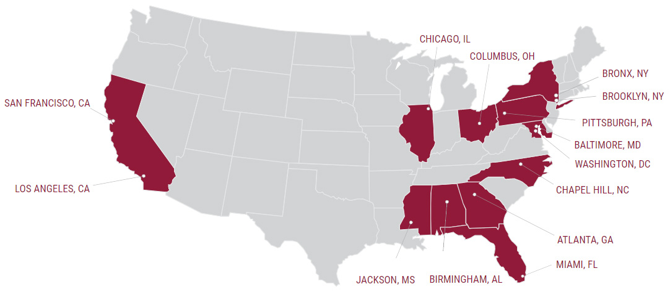
MWCCS Sites

Slide 7
The Combined Cohort
Multicenter AIDS Cohort Study (MACS)
Womens Interagency Study (WIHS)
30-year study of HIV in gay and bisexual men. MACS enrolled more than 7,300 study participants
4 clinical research sites and a data coordinating center
Sites
  Pittsburgh
  Chicago
  Baltimore
  LA
Largest and longest cohort study of women with HIV in the US
WIHS began in 1993.
Sites - Atlanta, GA; Birmingham, AL; Jackson, MS; Chapel Hill, NC; Chicago, IL; Miami, FL; New York City, NY; Los Angeles, CA; San Francisco, CA; Washington, DC
The two cohorts merged in 2019 to form the MWCCS

Slide 8
Study Aims - MWCCS
Cardiovascular
Pulmonary/Sleep
Neurocognitive
Aging
Cancer
HIV Pathogenesis
Psychosocial
Health Disparities
Career Development Aims

Slide 9

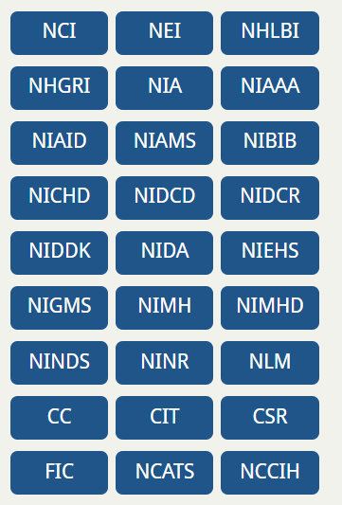
National Institute of Allergy and Infectious Diseases (NIAID)
National Heart Blood Lung Institute (NHLBI)
National Cancer Institute (NCI)
National Institute on Aging (NIA)
NIDA = National Institute on Drug Abuse
National Institute on Mental Health
National Institute of Child Health and Human Development (NICHD)
National Institute of Dental and Craniofacial Research (NIDCR)
National Institute of Neurological Disorders and Stroke (NINDS)
National Institute of Nursing Research (NINR)
National Institute on Alcohol Abuse and Alcoholism (NIAAA)
National Institute on Deafness and Other Communication Disorders (NIDCD)
National Institute of Diabetes and Digestive and Kidney Diseases (NIDDK)

Slide 10
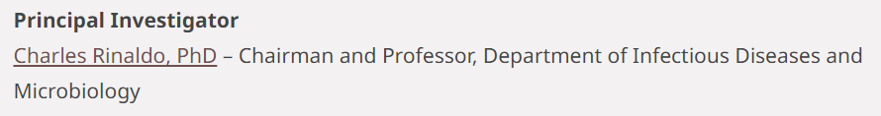
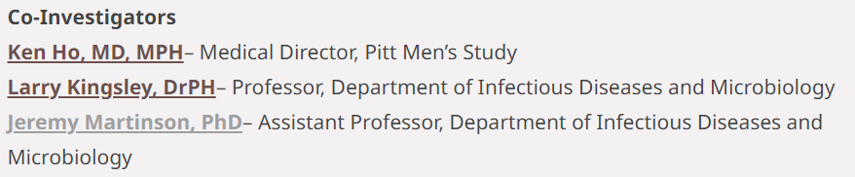
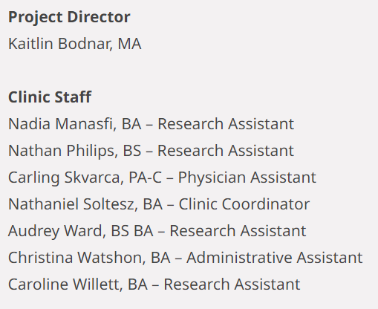
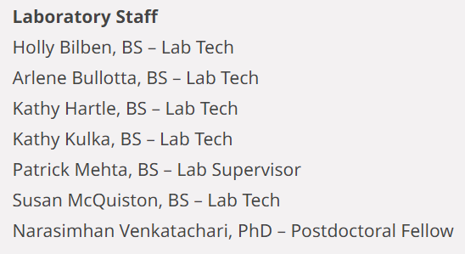
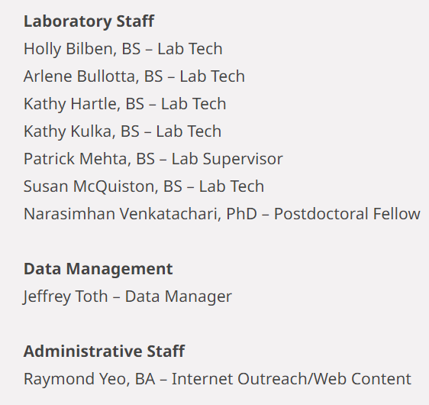

Slide 11
Visits at the Pitt Men’s Study
Bloodwork, Urine, other Specimens
Surveys and Interviews
Other Studies (Echocardiogram, PFTs, Neuropsychiatric testing)
Substudies
Payment
Follow up scheduled for 6 months (on average)

Slide 12
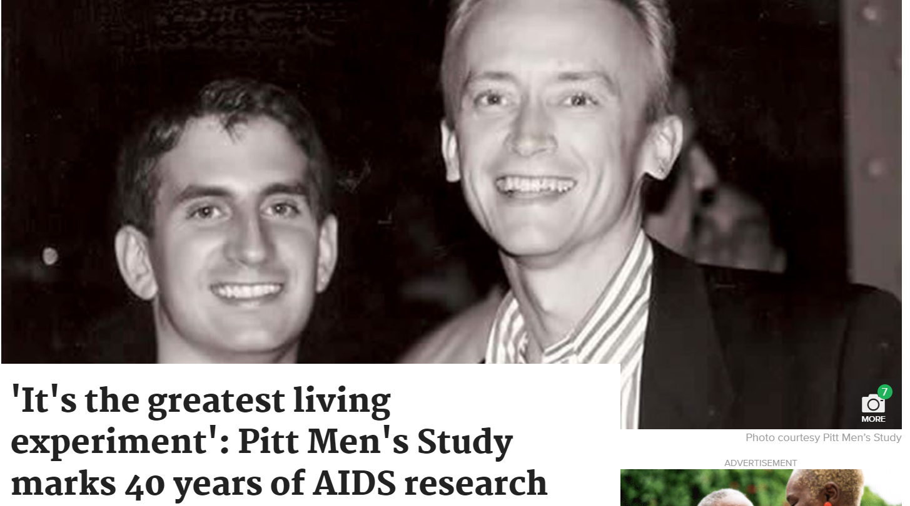

Slide 13
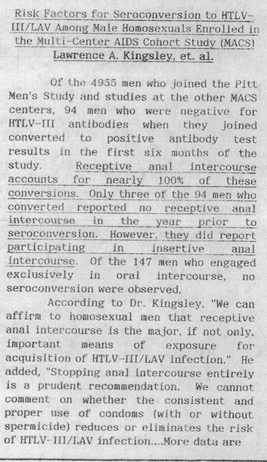

Slide 14
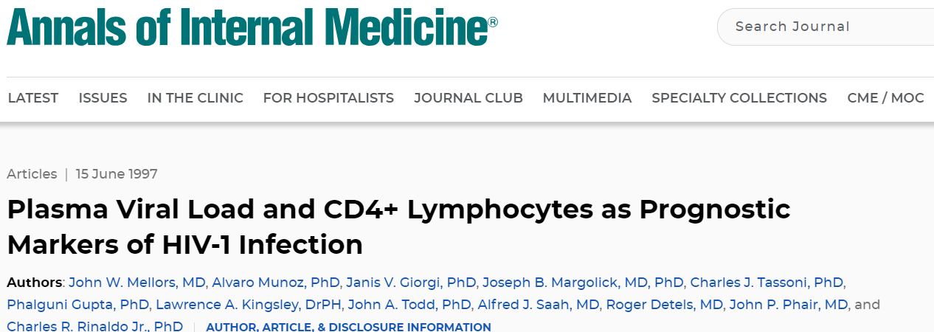
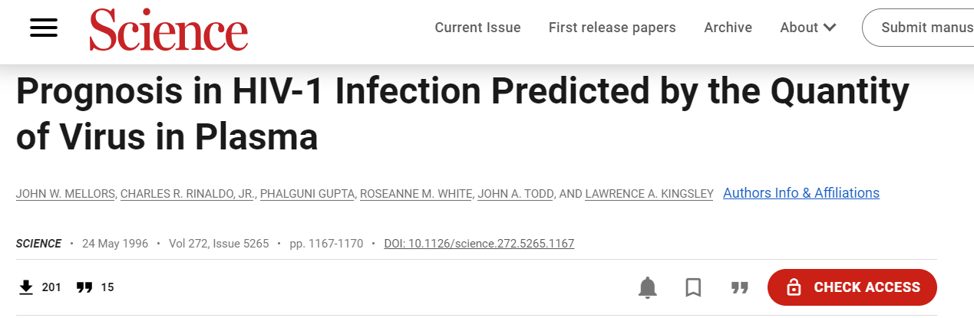
John Mellors and colleagues from the Multicenter AIDS Cohort Study (MACS) established that higher HIV viral loads were associated with progression of HIV disease and mortality, independent of CD4-cell count (Ann Intern Med 1997; 126:946, Science 1996; 272:1167, and ACC Aug 1 1997, p. 64, and Jul 1 1996, p. 60

Slide 15
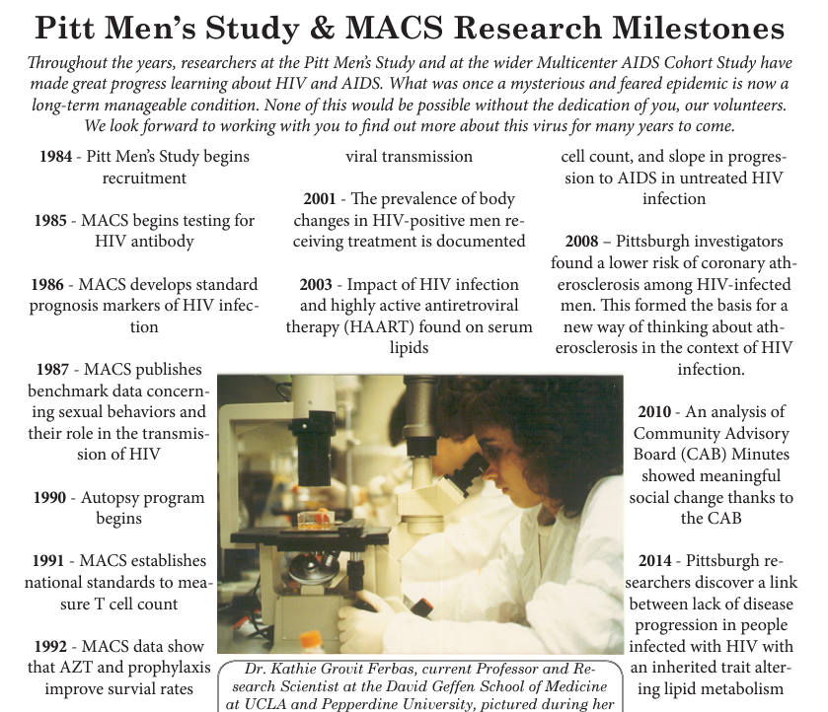

Slide 16
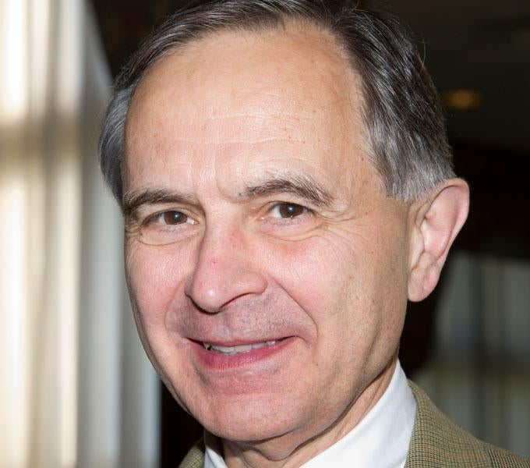
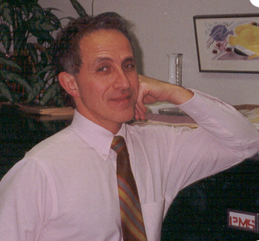
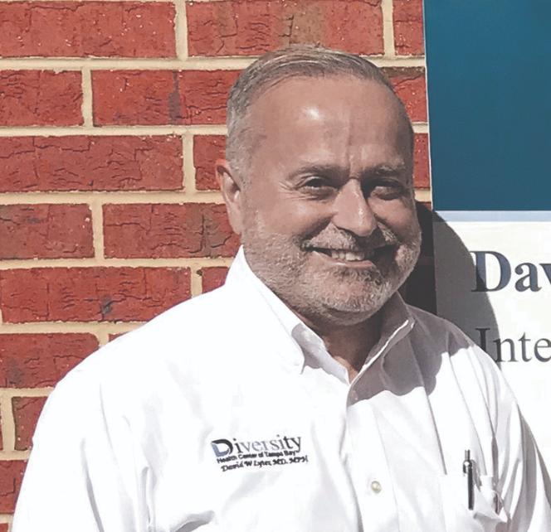
In the Beginning…
Charles Rinaldo, PhD
Tony Silvestre, PhD, MSW
David Lyter, MD

Slide 17
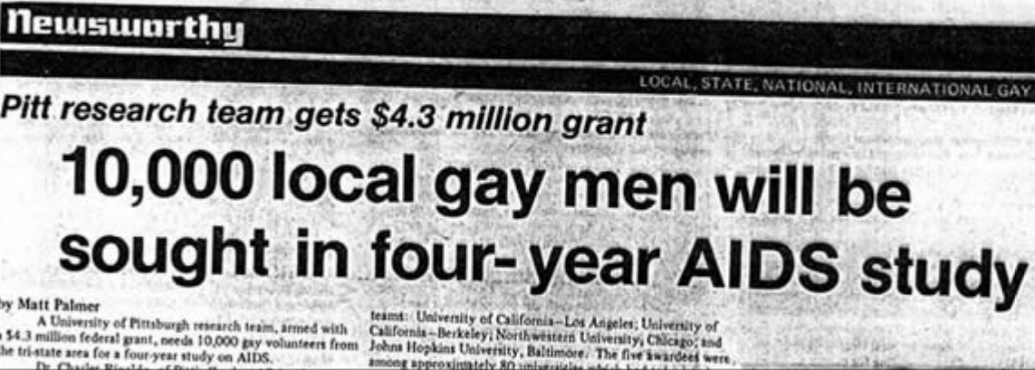

Slide 18
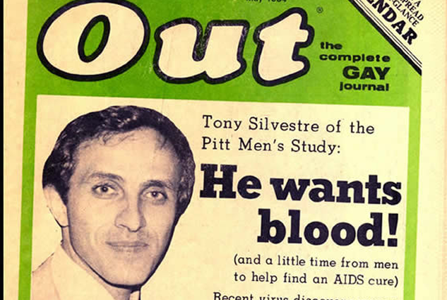


Slide 19
How did they do it?
Approached the Tavern Guild - collaborative of owners of various Pittsburgh bars and bathhouses
In person recruitment – offered education, HIV testing in bars and clubs, picnics, social events
Chuck Rinaldo, Tony Silvestre, Rick Witt, and other members of the team would be present and directly interact with community
Leveraged social connections with community champions
Involvement of PERSAD (mental health), faith communities (MCC)
Expanded into areas beyond Allegheny County
  Johnstown
  Youngstown
  Erie
  Wheeling

Slide 20


Slide 21
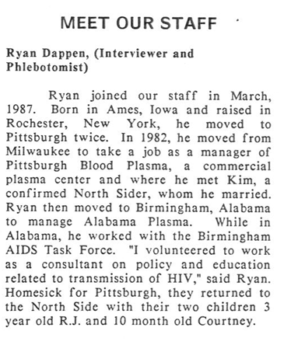
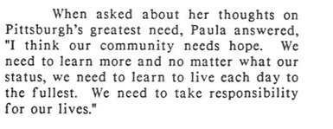
Pitt Mens Study Newsletter

Slide 22
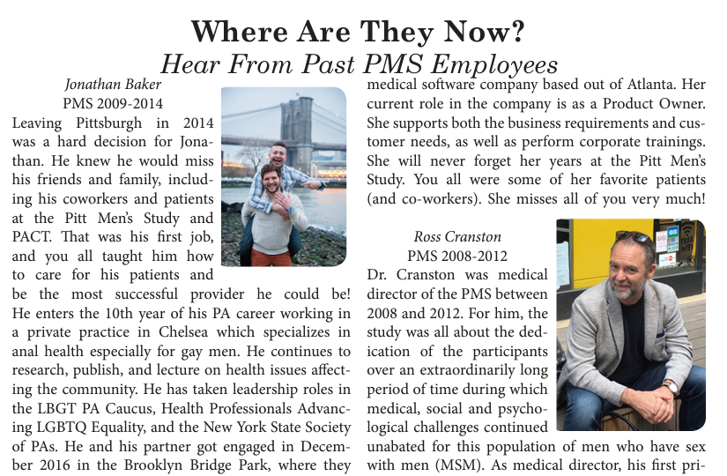

Slide 23
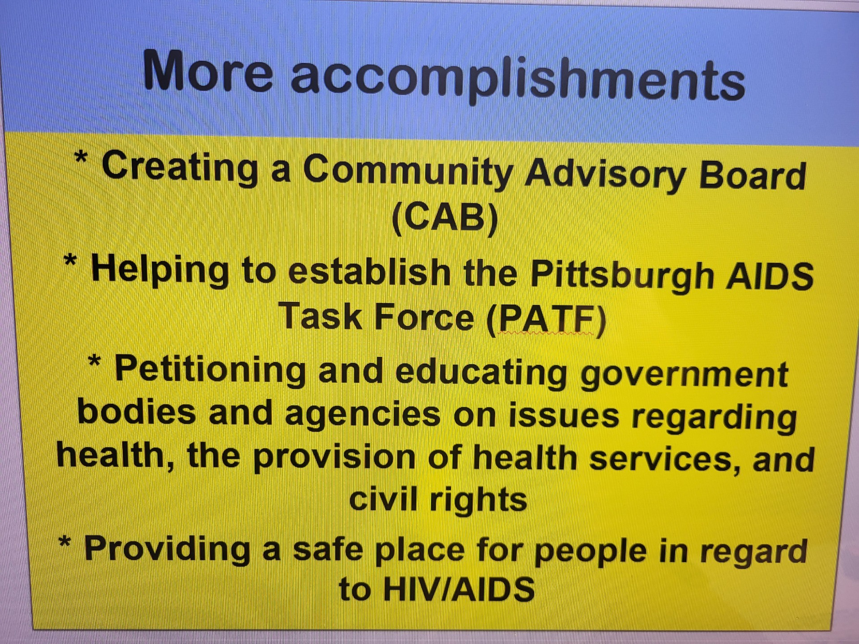

Slide 24
Confidentiality
“PMS Clinic” – otherwise unmarked
Clinic was outside University of Pittsburgh
Phone calls – “from the University of Pittsburgh”
Staff would not approach participants in the community
Staff signed confidentiality agreement
Labs and testing released only with permission

Slide 25

Feeling Safe
This was a time when people living with HIV and members of the LGBT community did not have a place to feel safe. Pitt Mens Study gave them a place to go to feel safe. People felt safe to be themselves”
“Many participants didn’t feel comfortable that their physicians knew about HIV. Some people didn’t even want their health care providers to know because they were afraid of being judged or rejected. People needed a place to get facts and true information. Pitt Mens Study was that trusted spot”
Carol Mitchell, RN

Slide 26
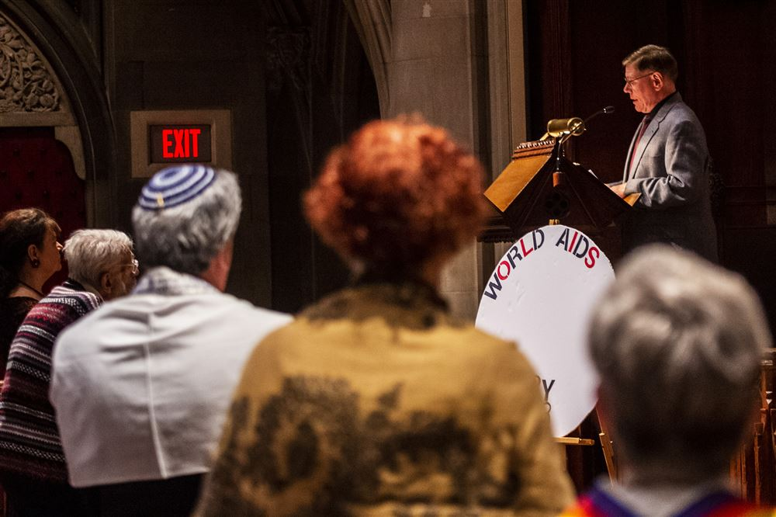
Remembering the past

Slide 27
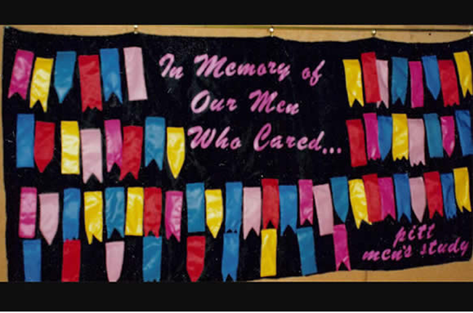

Slide 28
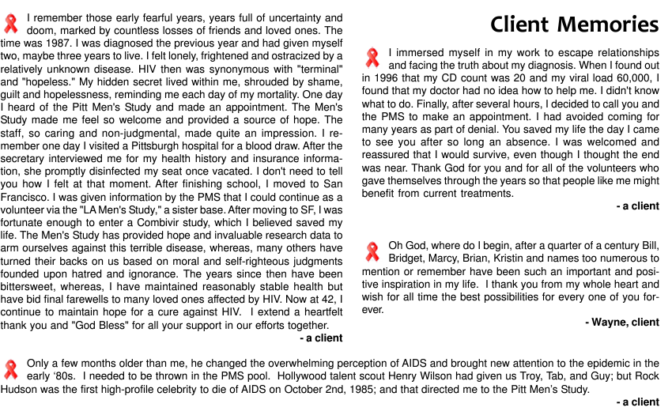

Slide 29
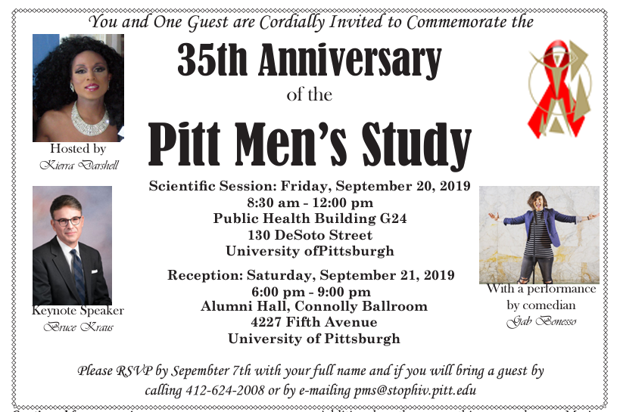

Slide 30
Caring for Participants
Participants placed great value in clinical testing and physical examinations done as part of the study
Labs and Testing done as part of the study were sometimes the only “HIV care” some participants received
Clinical staff sometimes provided care outside of the clinic
Staff could escort participants to PACT (Pittsburgh AIDS Center for Treatment) to receive care
Referral for other support services

Slide 31
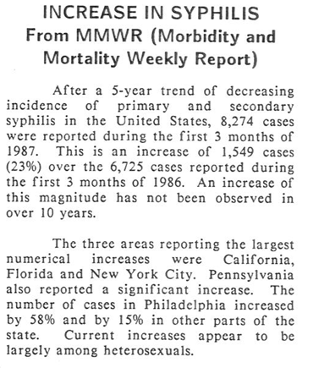
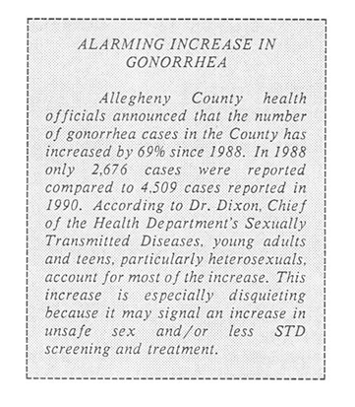
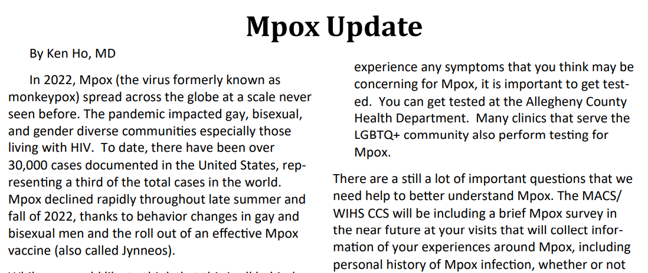

Slide 32
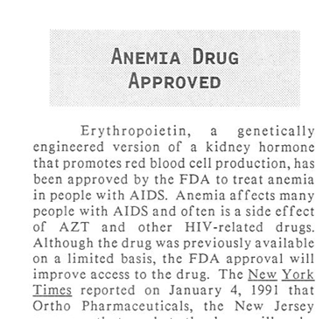
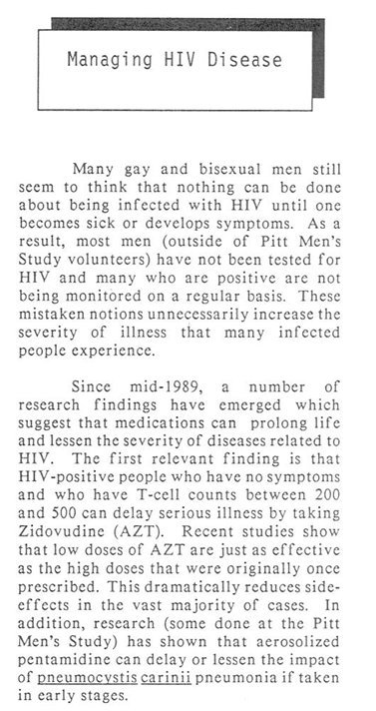

Slide 33
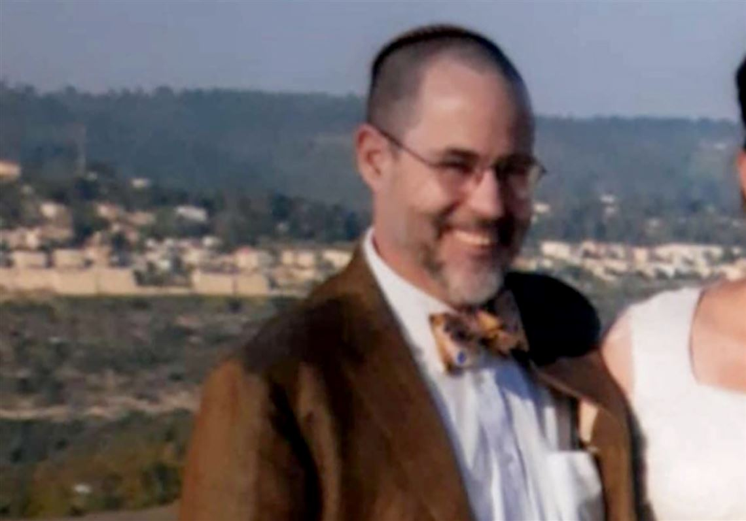

Slide 34
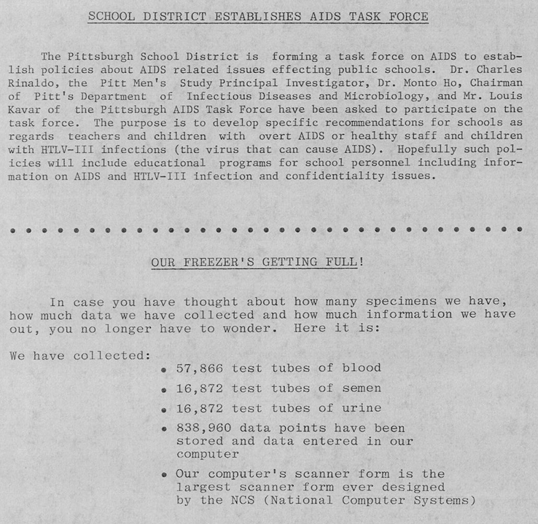

Slide 35
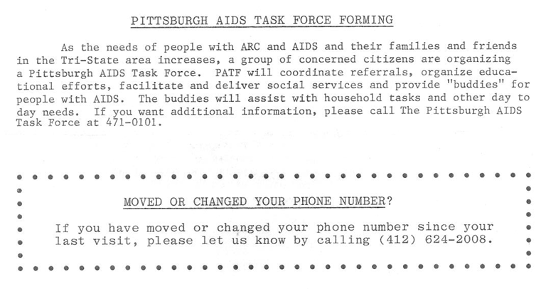

Slide 36
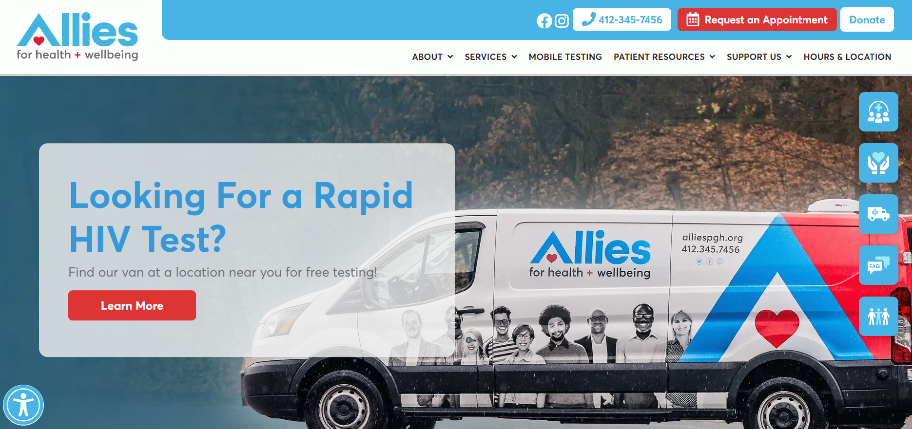


Slide 37
https://www.youtube.com/watch?v=jFNDZZVxFD4

Slide 38
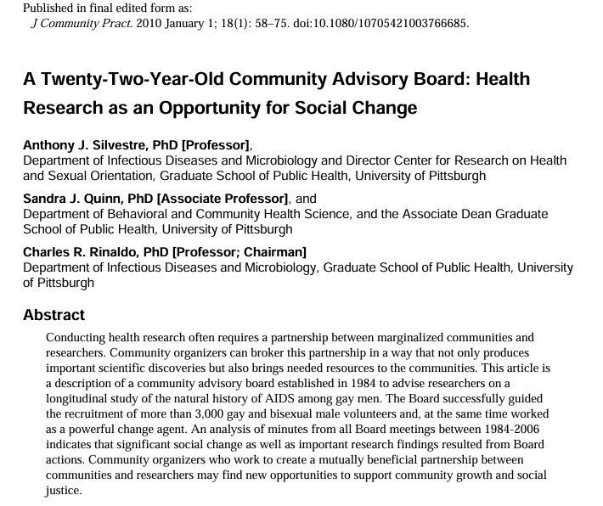
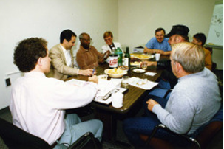
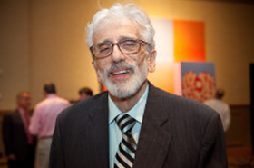
August “Buzz” Pusateri – former CAB Chair

Slide 39
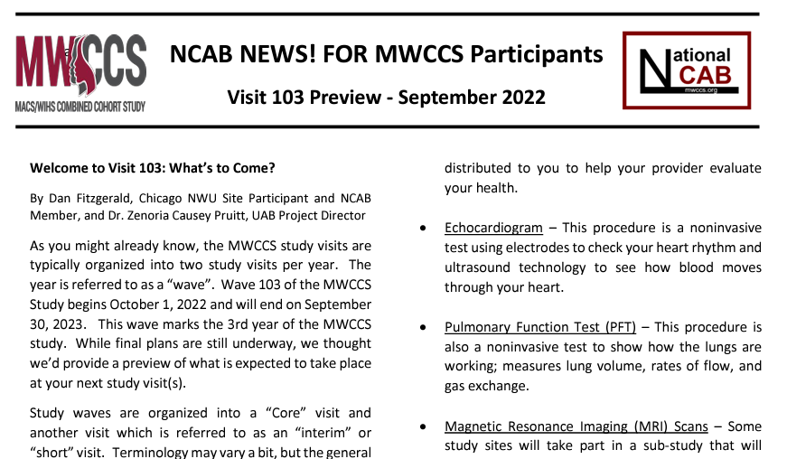

Slide 40
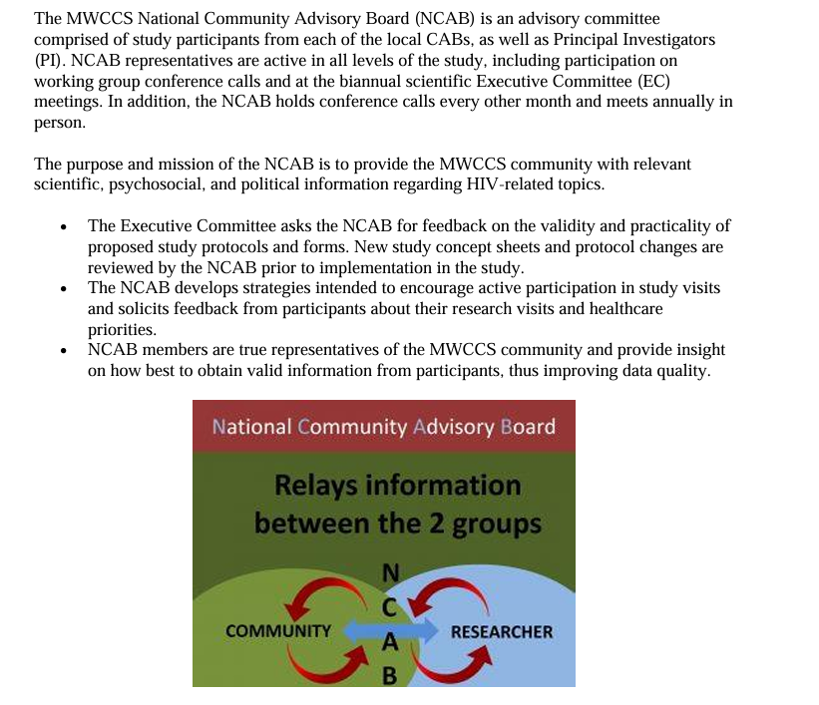
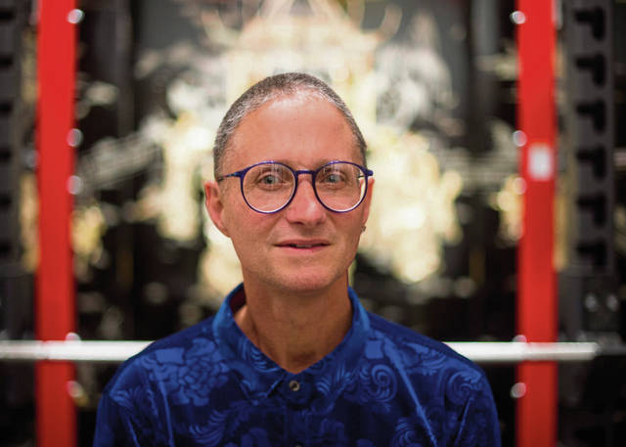
Marc Wagner, former NCAB chair

Slide 41
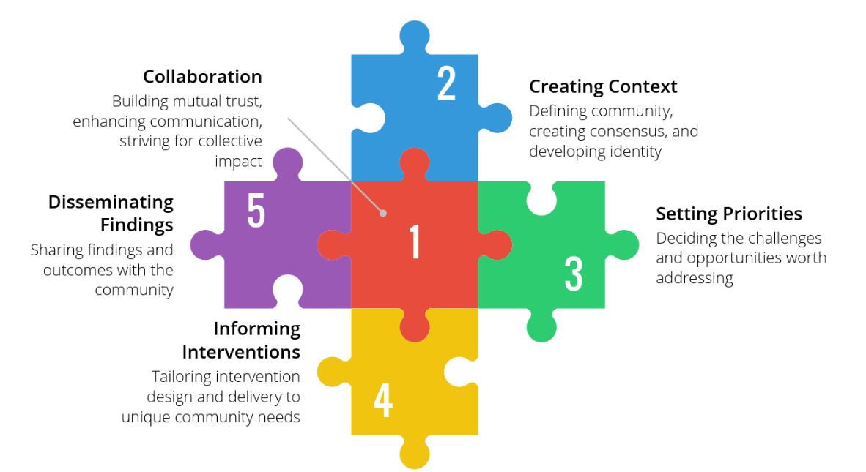

Slide 42
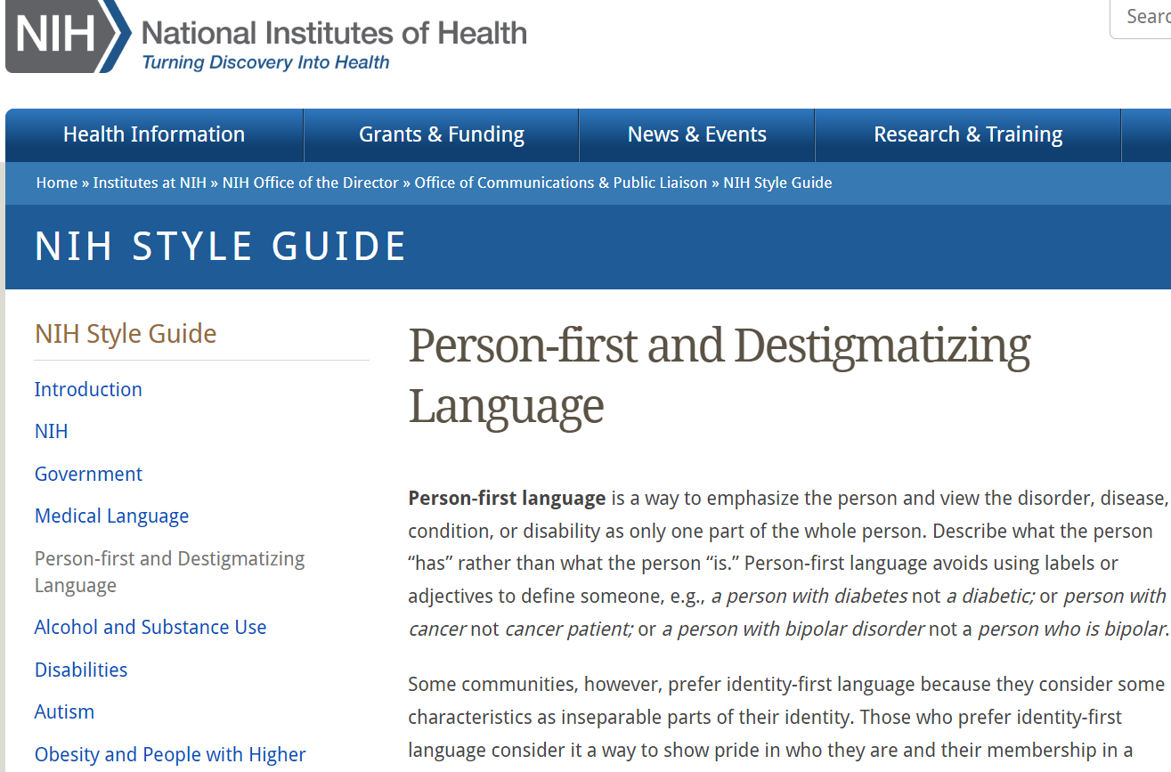

Slide 43
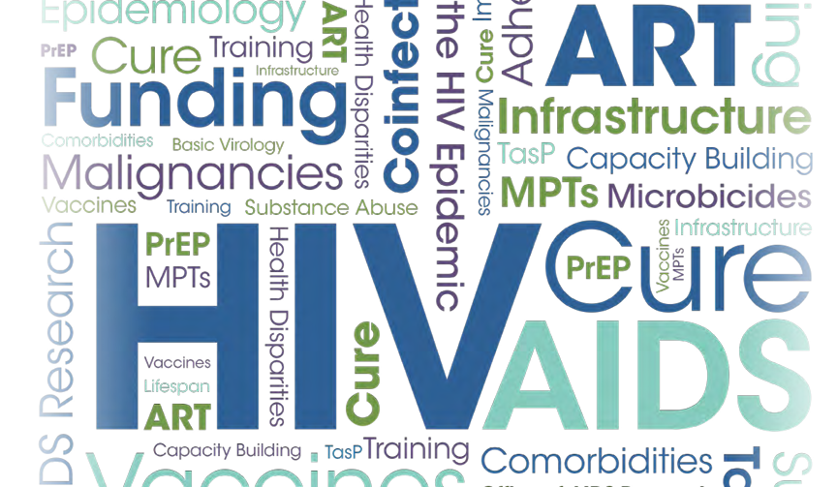

Slide 44
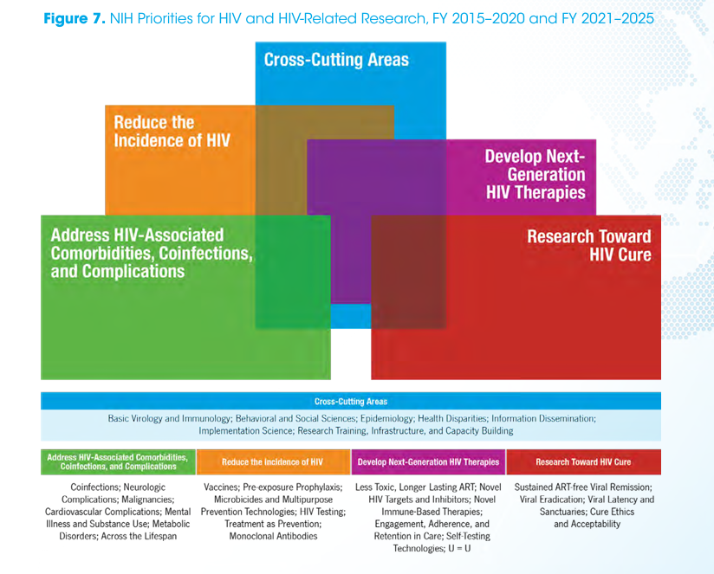

Slide 45
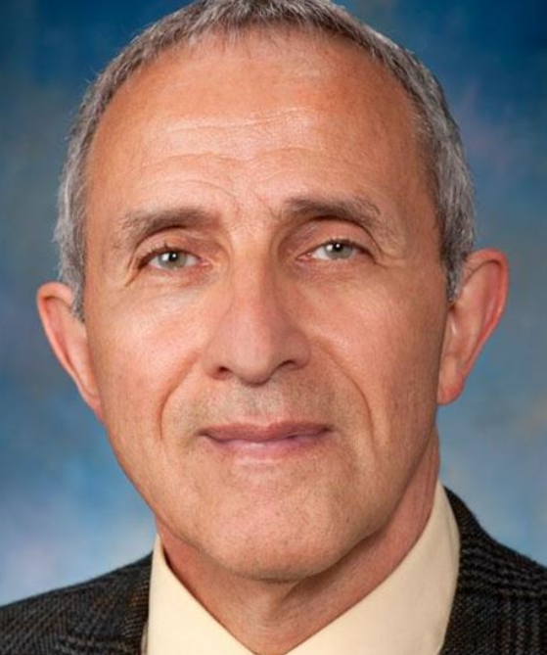
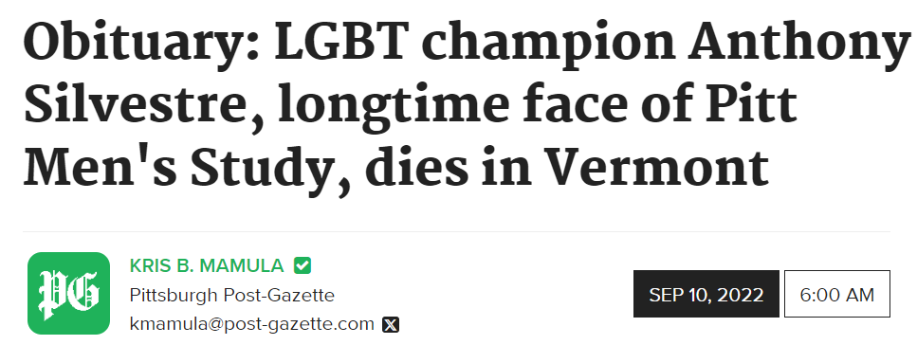

Slide 46

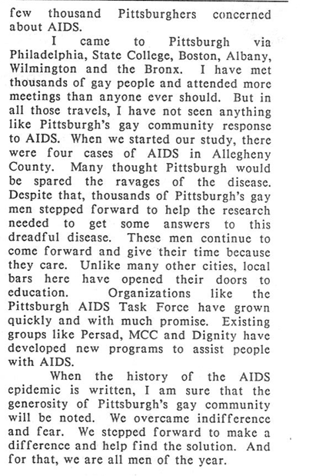

Slide 47


